Slide 1







Mapathon
‘Let’s get mapping…!’
Notes:
Hoe ben ik hier terecht gekomen? Ik vraag het mij wel eens af. Ik ben gewoon een tikkeltje gek van OpenStreetMap, maar daar heb je niet zo heel veel voor nodig. Ik geloof dat inspanningen om de OpenStreetMap gemeenschap minstens zo nuttig zijn als zelf mappen. En daarvoor treed ik graag buiten mijn comfort zone. Maar ik weet of kan niets meer dan om het even wie van jullie.
If I’m boring you, just follow the instructions on your desk and start working on the task numbers you find on the wifi password page

Slide 2
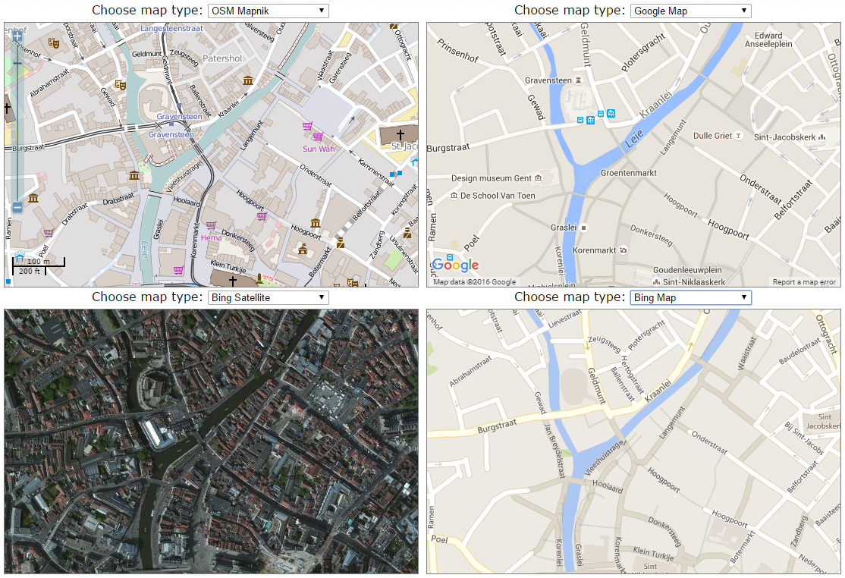
Notes:
In Western Europe, we take maps for granted. They are everywhere, we can just pick and choose. OSM is pretty cool, but just one of the many

Slide 3
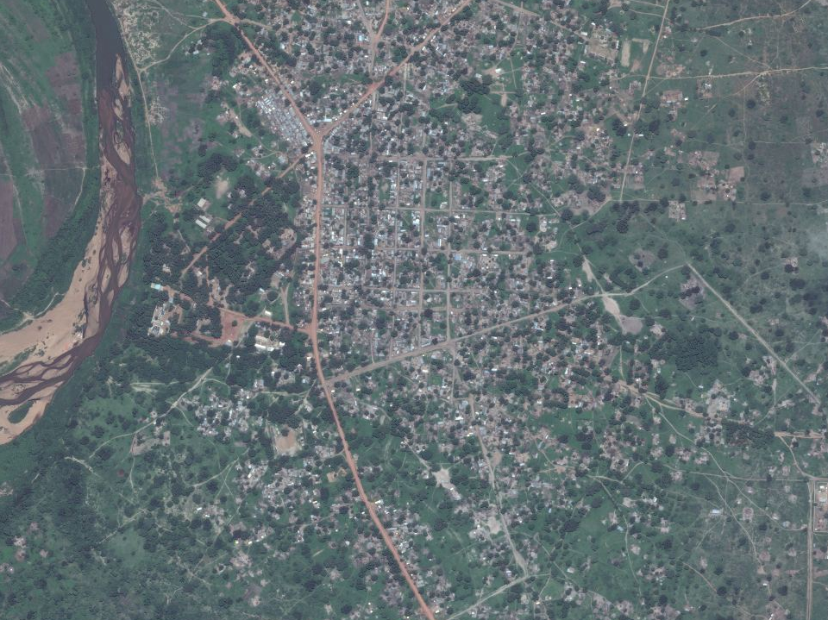
Luchtfoto van Goré, Tjaad
Drie vluchtelingenkampen
Een plek zoals er velen zijn in Afrika
Notes:
But what about a town somewhere deep in Chad? What about new refugee camps?

Slide 4
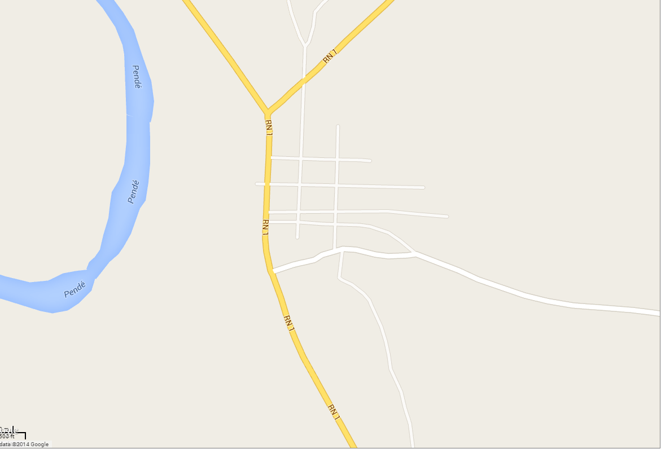
Goré, Tjaad op Google Maps
Notes:
Google Maps has little interest in places like this. There is no money to be made, people are poor and hardly use their services. It's commercially not interesting to map a place like this for companies. Also governments don't have the means to map this regions.

Slide 5
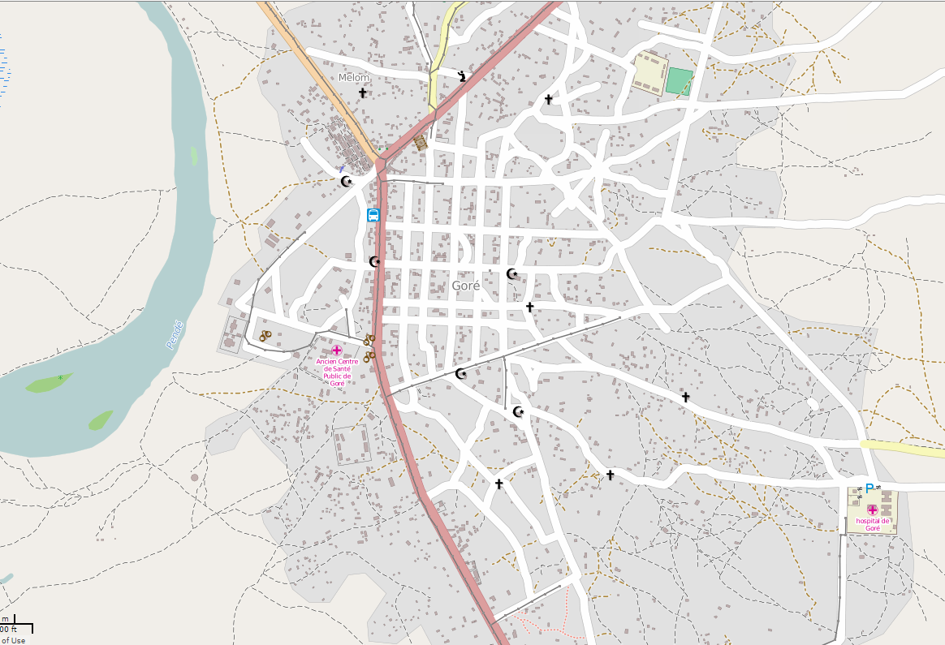
Goré, Tjaad op OpenStreetMap
Notes:
But in OpenStreetMap, it looks like this. Where there's interest, there can be a map.

Slide 6
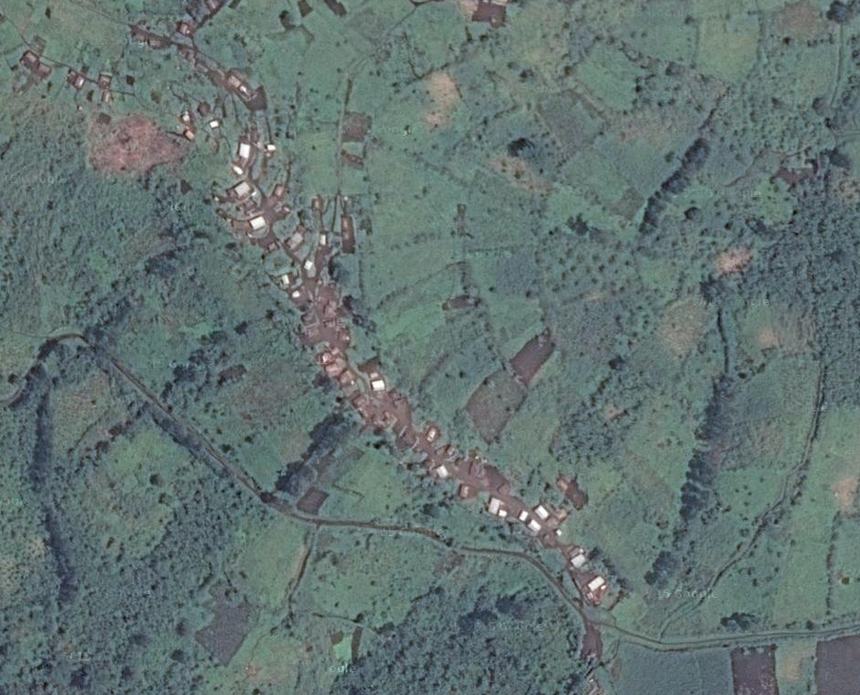
Luchtfoto van een dorpje in de regio Bangassou, Centraal Afrikaanse Republiek
Dorpje in het diepe binnenland
Geplaagd door geweld van allerlei groeperingen
Somewhere near Masisi
Notes:
but OSM isn't quite finished yet.

Slide 7


Slide 8
And that’s what we’re going to change today
Vergelijk zelf de online kaarten

Slide 9
But why would we do this ourselves with OpenStreetMap?

Slide 10
Het is sneller!
We’re quick
(and we want to be even quicker)
Notes:
we're fast - we can coordinate our mapping at times of disaster to create top notch maps in no time. But that relies on experience mappers - and that's what we want you to become

Slide 11
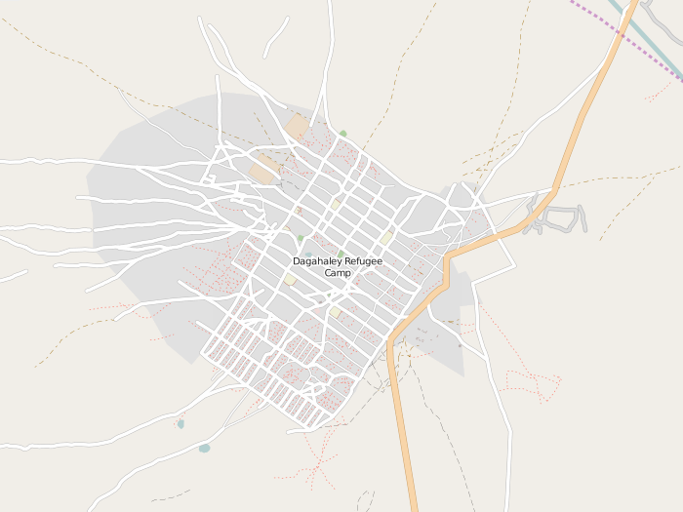
We decide what we map!
Dagahaley vluchtelingenkamp, Kenia
Notes:
we decide what to map. If it exists, we can map it. We can adapt our map to map and show anything, like refugee camps ignored by local government.

Slide 12
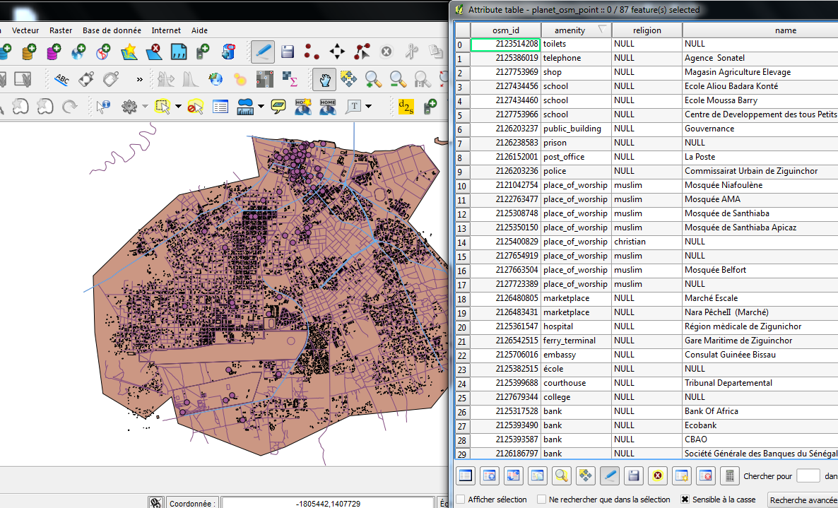
It’s open!
Notes:
it's open. Google Maps is just a service: you use it as Google sees fit. You can use OSM for what you want, like geographic analysis, generating lists of places to visit, personalised maps, offline navigation, etc. You can not download google map data on your computer, OSM map data you can.

Slide 13
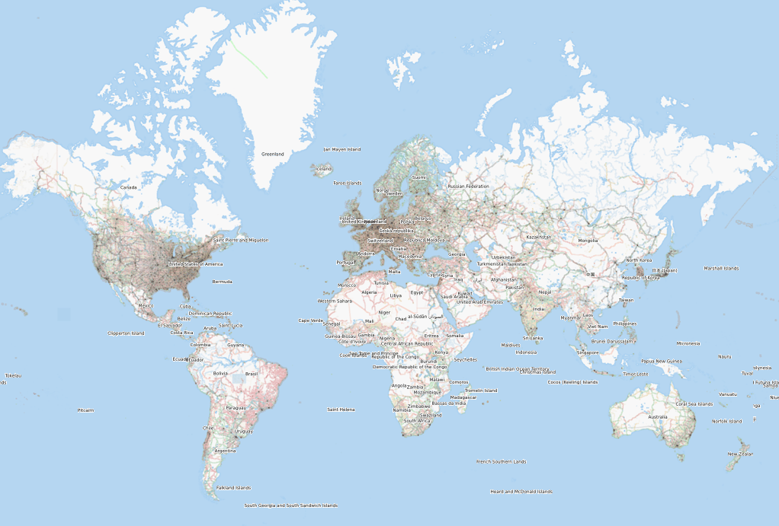
It is just one map
Mission OpenStreetMap: Mapping the entire world!
Notes:
it goes beyond a single project. What we do goes into a single global map, insuring updating, reuse and sharing, and making the development of new tools more efficient

Slide 14
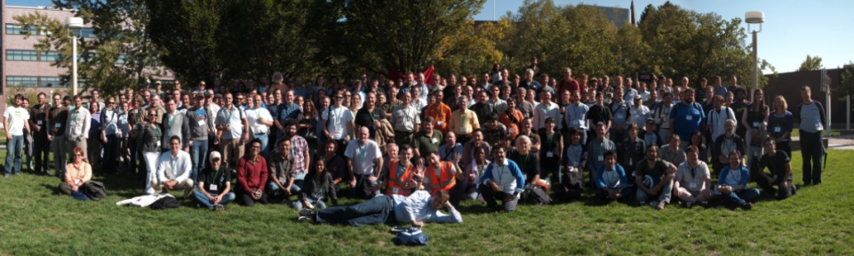
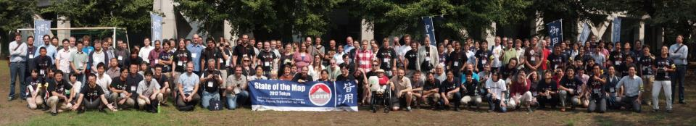
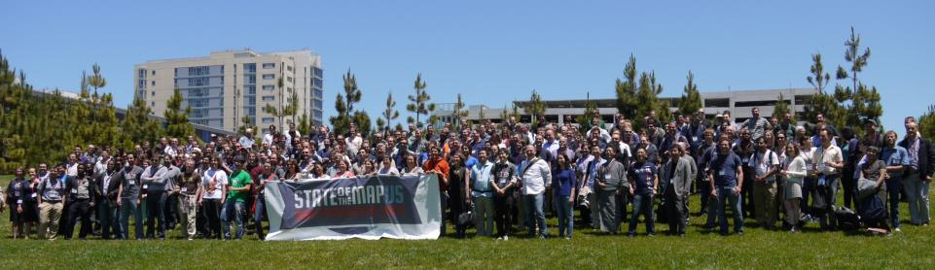
And there’s over 600,000 of us working on it!
Notes:
we're not alone! Over half a million people are building this thing with us.

Slide 15
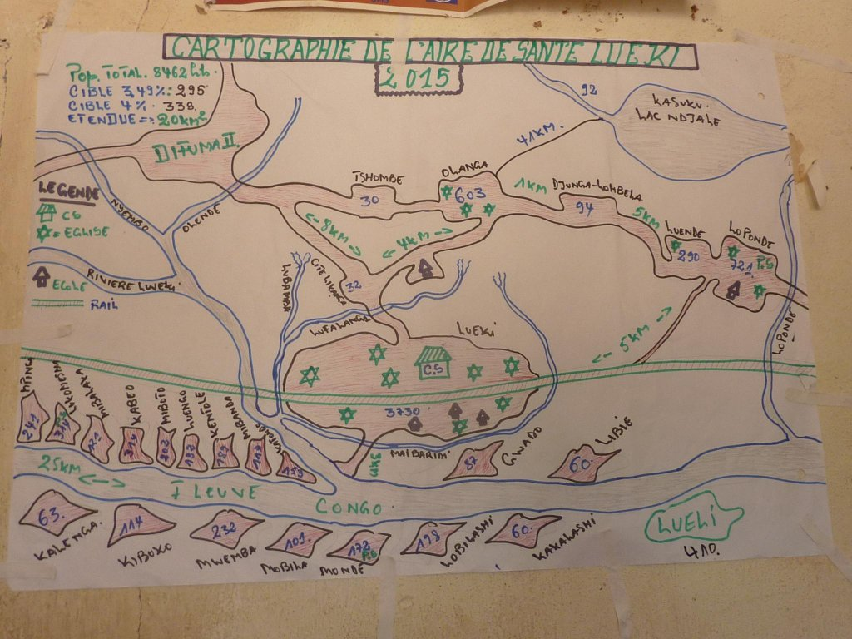
Notes:
for example, as a team of DwB rides up the Congo to prevent the spread of a potential epidemic they are lucky to find a map like this. While useful, this could be much better. If they would have a map of this quality before setting out, planning would be easier and more efficient

Slide 16
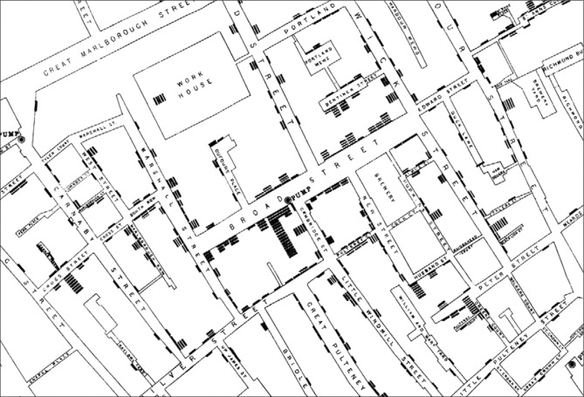
Notes:
Maps aren't just for navigating. This map was used to identify the cause of cholera - water wells, not fogs from the Thames, in London - before bacteria were even discovered.
During the recent Ebola outbreak, it was crucial to be able to map patterns of new cases. To do that, you have to be able to pinpoint people with symptoms on the map based on the name of their village. There is no way to do this right without good map data.

Slide 17
So what exactly are we going to do?
Notes:
that's all good and well, but, um, what are we going to do about all this now?

